Slide 1
Music Learning Experience

Slide 2
Team Members
Adam Tait, taitah@mail.uc.edu
Eric Gatto, gattoej@mail.uc.edu
Jason Judas, judisjt@mail.uc.edu
John Rose, rose2j4@mail.uc.edu
Advisor:
Prof. Carla Purdy, purdycc@ucmail.uc.edu

Slide 3
Project Description - Abstract
We will create a device and application that can easily teach kids about music. This will include the production of an electronic piano-like device using a Microchip board and a 3-D printed body. The devices body will be designed for kids, a smaller form factor, hard to break, and colorful. Our software is going to be built to be robust yet simple so kids can pick it up and learn with little outside intervention. Our hope is to teach kids about music theory and creation in a fun and educational environment.

Slide 4
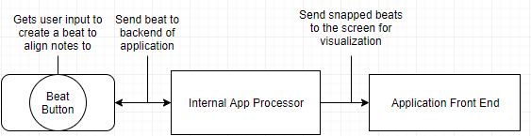
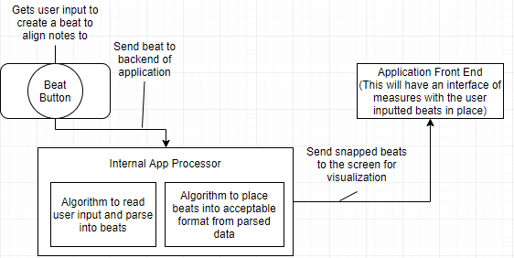
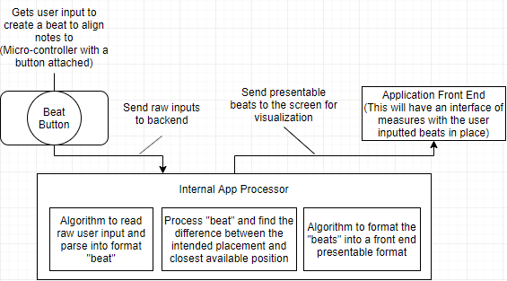
Project Description - Design Diagrams

Slide 5
Project Description - User Stories
As a child, I want to learn the basics of music so I can make my own music.
As a music teacher, I want an easy to use tool to help teach my students.
As a music student, I want an app to help me learn the fundamentals of music

Slide 6
Project Description - Constraints
Our only big constraint is economically. We are personally funding the project and costs will be driven as low as possible to emulate a production cycle.
Another smaller constraint is, using children for testing. We have limited access to children to test the product on which means we will not have a large sample size.

Slide 7
Review of Project Progress
Current State of Project:
Finalizing initial hardware
Discussing software architecture
Research on printing filament
Expected End of Term Accomplishments:
Have hardware onhand
Basic software architecture designed
Prototype of piano body

Slide 8
Division of Work
Adam Tait
Create Visual Interface
Make sounds for the application
Come up with interface that is interacted with
Create half of the graphics
Research music teaching techniques
Eric Gatto
Make 3D model
Print 3D model
Research best filaments (LEDs?) to print
Data structure for file (for saving and loading songs)
Create other half of the graphics
Jason Judias
Design main menu
Choose best technologies to use (IDE,language etc)
Create a tutorial
Design UI interaction elements
Find kids for testing
John Rose
Research micro controller
Parsed serialized input so they become usable
Research bluetooth (is it reasonable?)
Implement saving and loading
Convert micro controller output to note value

Slide 9
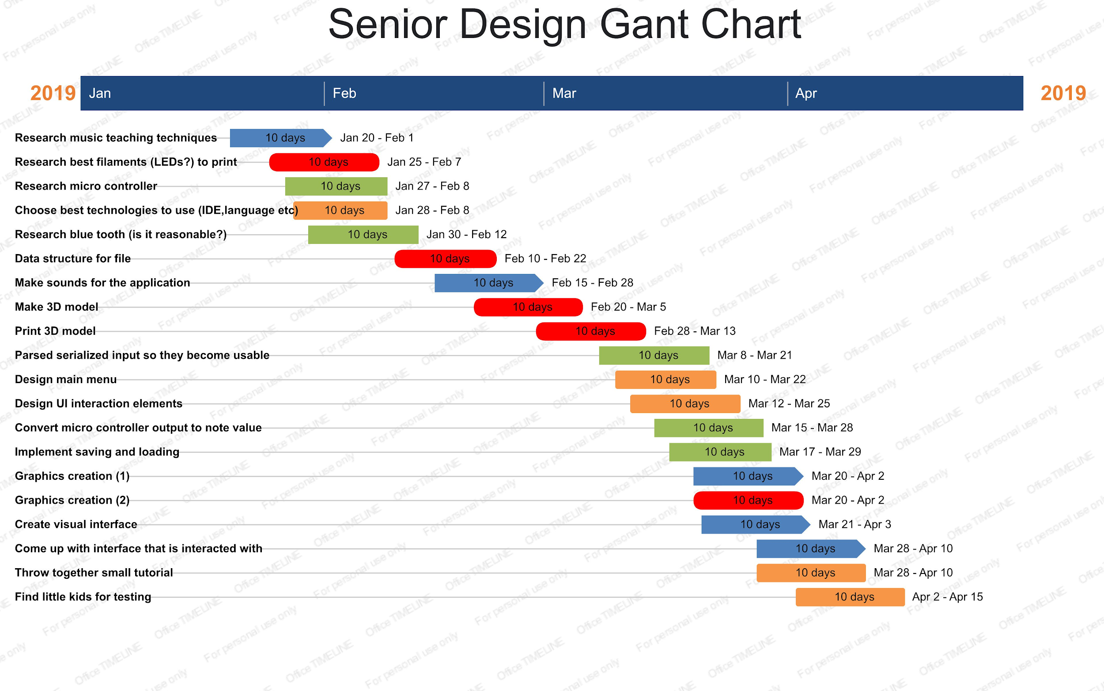
Timeline

Slide 10
Expected Demo
At the expo we expect to have a fully functioning application. We also plan on having the 3D printed electronic piano to interact with the application.

